Slide 1


Cloud for AI
Course 3: Scoping
Filotas Theodosiou

Slide 2
What are we going to talk about today

Slide 3
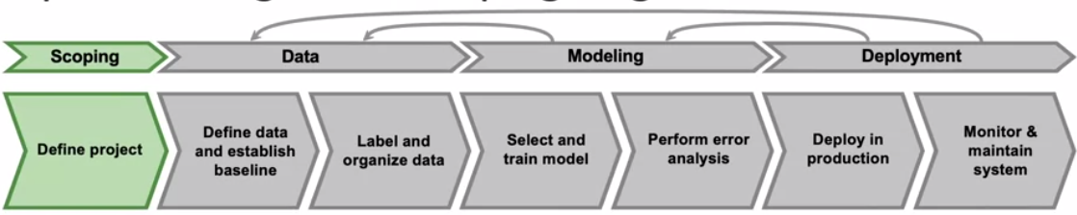
The Scoping Process
Scoping stage
Decide to work on the speech recognition task for voice search & classification
Decide on the key metrics
Note: Metrics might be different compared to a normal data science project
Accuracy, latency
Estimate resources and timeline

Slide 4
How to Define and Structure your Project

Slide 5
How to pick a project to work on

Slide 6

How to pick a project to work on
Inexperienced Graduate Student
Jump to the first project on your mind
Be excited about it
Sometimes be lucky and work out okay
Spend many hours and finally drops it

Slide 7
A Scoping Example
Scoping: Ecommerce retailer (Nikon) looks to increase sales.
What do you do?

Slide 8
A Scoping Example
Scoping: Ecommerce retailer (Nikon) looks to increase sales.
What do you do?
Brainstorm ideas
Better recommender system
Better search
Improve catalog data
Inventory management
Price optimization

Slide 9
A Scoping Example
Scoping: Ecommerce retailer (Nikon) looks to increase sales.
What do you do?
Brainstorm ideas
Better recommender system
Better search
Improve catalog data
Inventory management
Price optimization
Questions
What project should we work on?
What are the metrics for success?
What are the resources (data, time, people) needed?

Slide 10
A Scoping Example
Scoping: Ecommerce retailer (Nikon) looks to increase sales.
What do you do?
Brainstorm ideas
Better recommender system
Better search
Improve catalog data
Inventory management
Price optimization
Tip
Some ideas are more valuable than others (2,5,10 times) more
Spend your time wisely
Questions
What project should we work on?
What are the metrics for success?
What are the resources (data, time, people) needed?

Slide 11

Scoping process

Slide 12
Scoping process
Brainstorm business problems
(Not AI problems)

Slide 13
Scoping process
Brainstorm business problems
(Not AI problems)
Problem
Discuss with a business expert
What are the top 3 things:
Increased conversion(search to buy)
Reduced inventory
Increase margin (profit per item)

Slide 14
Scoping process
Brainstorm business problems
(Not AI problems)
Problem
Brainstorm AI solutions
Solution
Discuss with a business expert
What are the top 3 things:
Increased conversion(search to buy)
Reduced inventory
Increase margin (profit per item)

Slide 15
Scoping process
Brainstorm business problems
(Not AI problems)
Problem
Brainstorm AI solutions
Solution
Discuss with a business expert
What are the top 3 things:
Increased conversion(search to buy)
Reduced inventory
Increase margin (profit per item)
Assess the feasibility and value of potential solutions
Diligence

Slide 16
Scoping process
Brainstorm business problems
(Not AI problems)
Problem
Brainstorm AI solutions
Solution
Discuss with a business expert
What are the top 3 things:
Increased conversion(search to buy)
Reduced inventory
Increase margin (profit per item)
Assess the feasibility and value of potential solutions
Diligence
Determine milestones

Slide 17
Scoping process
Brainstorm business problems
(Not AI problems)
Problem
Brainstorm AI solutions
Solution
Discuss with a business expert
What are the top 3 things:
Increased conversion(search to buy)
Reduced inventory
Increase margin (profit per item)
Assess the feasibility and value of potential solutions
Diligence
Determine milestones
Budget for resources

Slide 18
Separating problems and solutions
Problem
Solution
Increase conversion
Reduce inventory
Increase margin
Search, recommendations
Demand predictions, marketing
Optimize what to sell, recommend bundles
What to achieve
How to achieve

Slide 19

Talking to a Business Expert Example
MUBER example from Course 2

Slide 20
Talking to a Business Expert Example
MUBER example from Course 2
“We want to increase customer satisfaction

Slide 21
Talking to a Business Expert Example
MUBER example from Course 2
“We want to increase customer satisfaction
“Any ideas on potential improvements?”

Slide 22
Talking to a Business Expert Example
MUBER example from Course 2
“We want to increase customer satisfaction
“Want to help taxi drivers understand the trips better to assist our customers”
“Any ideas on potential improvements?”

Slide 23
Talking to a Business Expert Example
MUBER example from Course 2
“We want to increase customer satisfaction
“Want to help taxi drivers understand the trips better to assist our customers”
“Any ideas on potential improvements?”
“Interesting. How do you understand trips?

Slide 24
Talking to a Business Expert Example
MUBER example from Course 2
“We want to increase customer satisfaction
“Want to help taxi drivers understand the trips better to assist our customers”
“We want to know why some trips take more”
“Any ideas on potential improvements?”
“Interesting. How do you understand trips?

Slide 25
Talking to a Business Expert Example
MUBER example from Course 2
“We want to increase customer satisfaction
“Want to help taxi drivers understand the trips better to assist our customers”
“We want to know why some trips take more”
“Any ideas on potential improvements?”
“Interesting. How do you understand trips?
“Like not-normal cases you mean?”

Slide 26
Talking to a Business Expert Example
MUBER example from Course 2
“We want to increase customer satisfaction
“Want to help taxi drivers understand the trips better to assist our customers”
“We want to know why some trips take more”
“Yes”
“Any ideas on potential improvements?”
“Interesting. How do you understand trips?
“Like not-normal cases you mean?”

Slide 27
Talking to a Business Expert Example
MUBER example from Course 2
“We want to increase customer satisfaction
“Want to help taxi drivers understand the trips better to assist our customers”
“We want to know why some trips take more”
“Yes”
“Any ideas on potential improvements?”
“Interesting. How do you understand trips?
“Like not-normal cases you mean?”
“Cluster those trips would be helpful.

Slide 28
Talking to a Business Expert Example
MUBER example from Course 2
“We want to increase customer satisfaction
“Want to help taxi drivers understand the trips better to assist our customers”
“We want to know why some trips take more”
“Yes”
“Any ideas on potential improvements?”
“Interesting. How do you understand trips?
“Like not-normal cases you mean?”
“Cluster those trips would be helpful.
Do you gather details about the trips”

Slide 29
Talking to a Business Expert Example
MUBER example from Course 2
“We want to increase customer satisfaction
“Want to help taxi drivers understand the trips better to assist our customers”
“We want to know why some trips take more”
“Yes”
“Yes, we have a lot of historical data”
“Any ideas on potential improvements?”
“Interesting. How do you understand trips?
“Like not-normal cases you mean?”
“Cluster those trips would be helpful.
Do you gather details about the trips”

Slide 30
Talking to a Business Expert Example
MUBER example from Course 2
“We want to increase customer satisfaction
“Want to help taxi drivers understand the trips better to assist our customers”
“We want to know why some trips take more”
“Yes”
“Yes, we have a lot of historical data”
“Any ideas on potential improvements?”
“Interesting. How do you understand trips?
“Like not-normal cases you mean?”
“Cluster those trips would be helpful.
Do you gather details about the trips”
“Can I access them to check if it is feasible?”

Slide 31
Talking to a Business Expert Example
MUBER example from Course 2
“We want to increase customer satisfaction
“Want to help taxi drivers understand the trips better to assist our customers”
“We want to know why some trips take more”
“Yes”
“Yes, we have a lot of historical data”
Of course.
“Any ideas on potential improvements?”
“Interesting. How do you understand trips?
“Like not-normal cases you mean?”
“Cluster those trips would be helpful.
Do you gather details about the trips”
“Can I access them to check if it is feasible?”

Slide 32
Talking to a Business Expert Example
MUBER example from Course 2
“We want to increase customer satisfaction
“Want to help taxi drivers understand the trips better to assist our customers”
“We want to know why some trips take more”
“Yes”
“Yes, we have a lot of historical data”
Of course.
….
“Any ideas on potential improvements?”
“Interesting. How do you understand trips?
“Like not-normal cases you mean?”
“Cluster those trips would be helpful.
Do you gather details about the trips”
“Can I access them to check if it is feasible?”
…

Slide 33
Diligence and Feasibility

Slide 34
Feasibility: Is this project technically feasible?
Ask yourself!
Before starting your project, how do you know that this thing can be even built?

Slide 35
Feasibility: Is this project technically feasible?
Ask yourself!
Before starting your project, how do you know that this thing can be even built?
Get a quick sense of feasibility with quick research.
Use external benchmarks (literature, github, medium, other company, a competitor)
eg. can you find someone that has already developed a good recommendation system?

Slide 36
Feasibility: Is this project technically feasible?
Ask yourself!
Before starting your project, how do you know that this thing can be even built?
Get a quick sense of feasibility with quick research.
Use external benchmarks (literature, github, medium, other company, a competitor)
eg. can you find someone that has already developed a good recommendation system?
Unstructured data
(eg audio, images)
Structured data
(eg tables etc)
HLP (human performance) Can a human detect phone scratches? If yes, then maybe an AI can too | Do I have predictive features? (For example, do I have past transactions to forecast news?)
HLP Set a performance goal. If a human can reach it, then maybe an AI can too | Do I have to find new features? Whats the history of the project?
New
(do a task for the first time )
Existing
(Already have a system and you look for improvement)

Slide 37
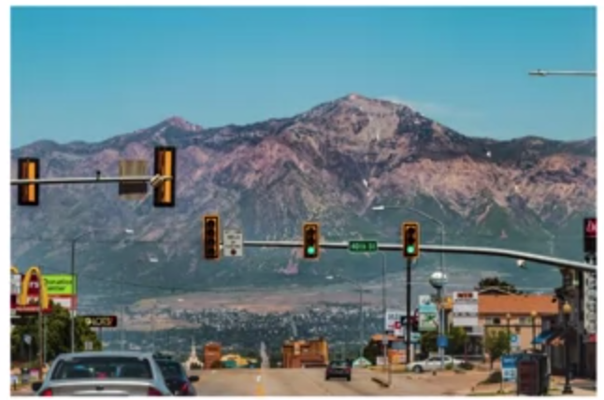
Why use HLP to benchmark?
People are very good at unstructured data tasks
Criteria: Can a human, given the same data, perform the task?
Example: You build self-driving cars and you want to classify the color of the traffic light

Slide 38
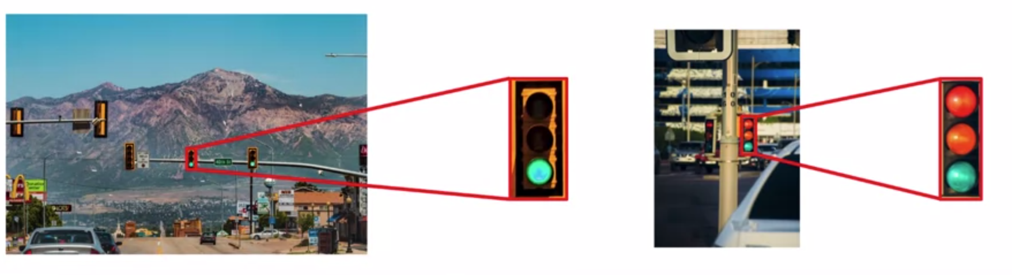
Why use HLP to benchmark?
People are very good at unstructured data tasks
Criteria: Can a human, given the same data, perform the task?
Example: You build self-driving cars and you want to classify the color of the traffic light
Sit down and think if you can solve an unstructured task

Slide 39
Why use HLP to benchmark?
People are very good at unstructured data tasks
Criteria: Can a human, given the same data, perform the task?
Example: You build self-driving cars and you want to classify the color of the traffic light
Sit down and think if you can solve an unstructured task

Slide 40
Why use HLP to benchmark?
If you cant, its better to invest time on other things
Better equipment
Better sensors (better traffic lights)

Slide 41
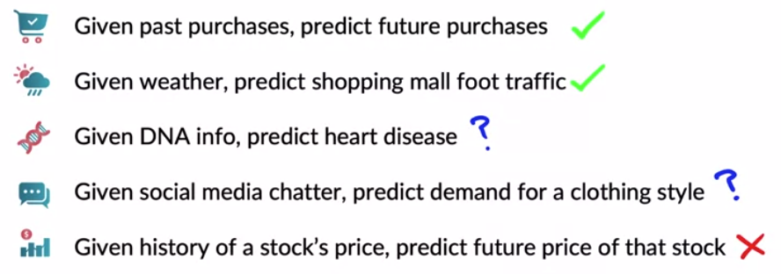
Do we have features that are predictive?
x y
Before jumping into our project its best to check if the solution is feasible given our data.

Slide 42
How to estimate the value of a ML project

Slide 43
Diligence on value: Bridge the gap
Example: You design a speech recognition app for web searches
People speak on their phone and the phone browse the web
MLE
Metrics
Business metrics

Slide 44
Diligence on value: Bridge the gap
Example: You design a speech recognition app for web searches
People speak on their phone and the phone browse the web
MLE
Metrics
Business metrics
main goal
main goal
World level accuracy
Revenue

Slide 45
Diligence on value: Bridge the gap
Example: You design a speech recognition app for web searches
People speak on their phone and the phone browse the web
MLE
Metrics
Business metrics
common ground?
main goal
main goal
World level accuracy
Revenue

Slide 46
Diligence on value: Bridge the gap
Example: You design a speech recognition app for web searches
People speak on their phone and the phone browse the web
MLE
Metrics
Business metrics
common ground?
main goal
main goal
World level accuracy
Search result quality
Revenue

Slide 47
Diligence on value: Bridge the gap
Example: You design a speech recognition app for web searches
People speak on their phone and the phone browse the web
MLE
Metrics
Business metrics
common ground?
main goal
main goal
World level accuracy
aim
aim
Query-level accuracy
Search result quality
User
engagement
Revenue

Slide 48
Diligence on value: Bridge the gap
Example: You design a speech recognition app for web searches
People speak on their phone and the phone browse the web
MLE
Metrics
Business metrics
common ground?
main goal
main goal
World level accuracy
aim
aim
Query-level accuracy
Search result quality
User
engagement
Revenue
Technical and business teams try to agree on metrics that are both comfortable with

Slide 49
Please, do not forget!
Ethical considerations:
Is this project creating net positive societal value
Is this project reasonably fair and free from bias
Have any ethical concerns been openly aired?
I think we should only work on project that give positive societal value!!

Slide 50
Milestones and Resourcing
Key specifications before starting a ML project
ML metrics (accuracy, precision/recall, etc.)
Software metrics(latency, throughput, etc
Business metrics
Resources needed
Timeline

Slide 51
Putting them all together

Slide 52
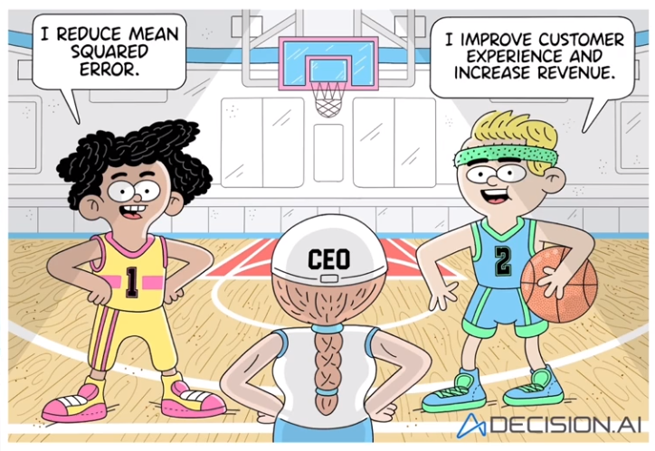
Which Data Scientist would you choose?

Slide 53
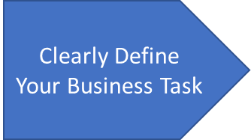
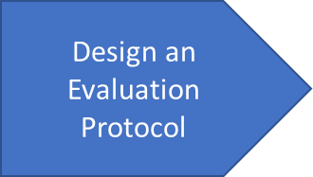
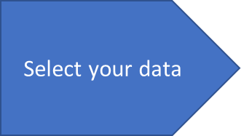
Scoping Key Stages
Before proceeding we need to answer the following questions
What problem are we trying to solve?
How are we going to approach it?
Do we need Machine Learning to solve it?
How do we know if our solution is good enough (Its never perfect, trust me!)
What kind of data we will need?

Slide 54
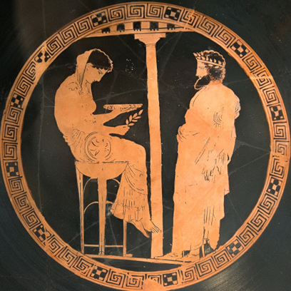
Dont Forget! Why Do We Use ML Systems?
“Planning is bringing the future into the present so you can do something about it now”
Machine learning assists individuals and businesses deploy solutions that:
Unlock previously untapped sources of revenue
Save Time
Reduce costs through more efficient workflows
Use data-driven methods for more effective decision making
Improve customer experience
Ancient Greeks went to Oracles to tell them the future
Notes:
The human brain is limited: Can only process a specific number of bits. According to techjury*, every person created at least 1.7MB of data per second in 2020

Slide 55
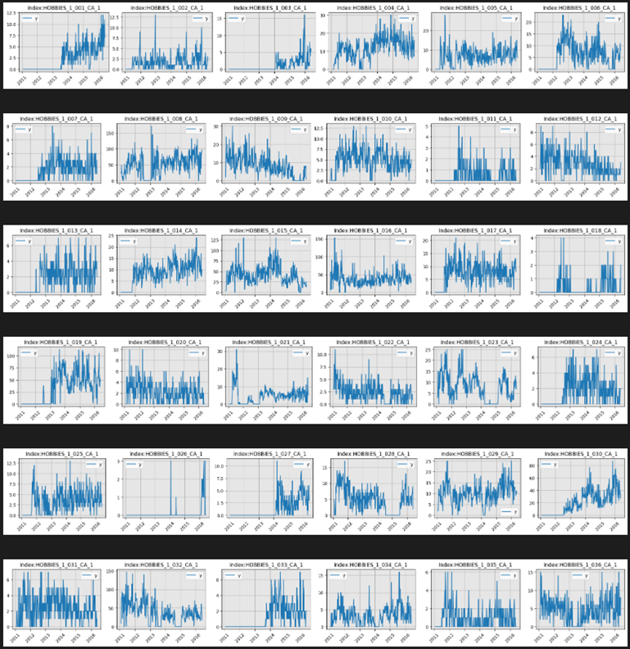
When Do We Consider ML Systems?
Automating Machine Learning operations means:
Faster go-to-market times
Lower operation costs
Assist managers and developers be more agile and strategic in their decisions
Every human creates 1.7MB of data every second
How many can the human brain process?
But: You cannot accomplish the goals of ML without a solid framework.
Notes:
link for the site

Slide 56
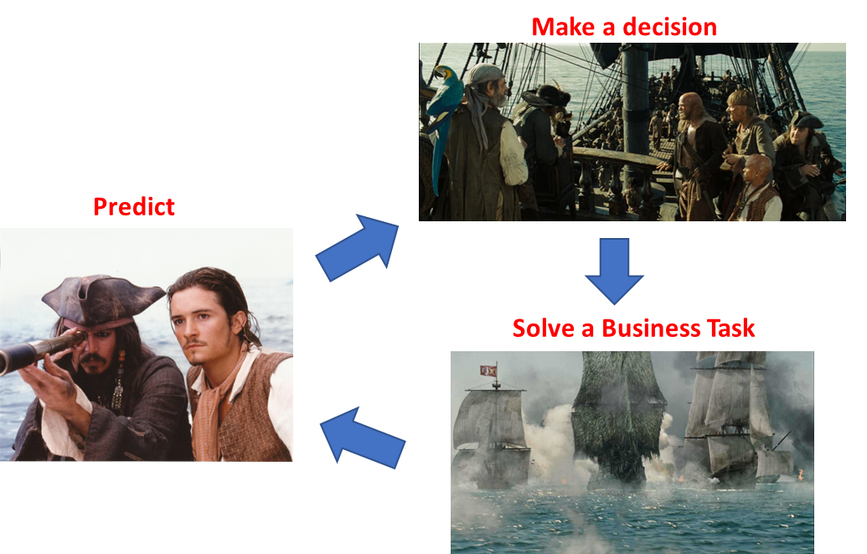
Step 1: Clearly Define your Business Objective
What is the task we are trying to solve?
What is the decision we want to automate/enhance?
What is the business problem we are going to solve with the decision?

Slide 57
Step 2:Clearly define the evaluation protocol
Business Metrics: Evaluate on the business task
For example revenue
Precise but difficult to be defined
ML Metrics: Evaluate on some properties of the prediction
For example accuracy, recall, MSE
Easy and cheap to use
Not 1-1 correlation with the business task
Notes:
How do I know that the predictions are good enough?

Slide 58
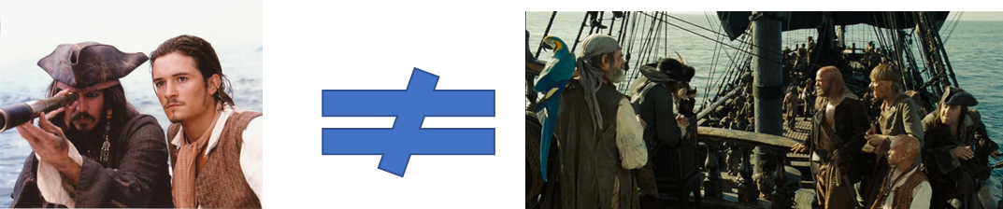
Step 2:Clearly define the evaluation protocol
Business Metrics: Evaluate on the business task
For example revenue
Precise but difficult to be defined
ML Metrics: Evaluate on some properties of the prediction
For example accuracy, recall, MSE
Easy and cheap to use
Not 1-1 correlation with the business task
We usually rely on ML metrics.
But remember:
Good performance on a ML metric
Good business decision
Notes:
How do I know that the predictions are good enough?

Slide 59
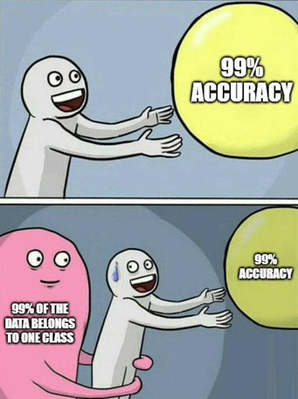
Low Accuracy Does not (Always) Mean Good Performance

Slide 60
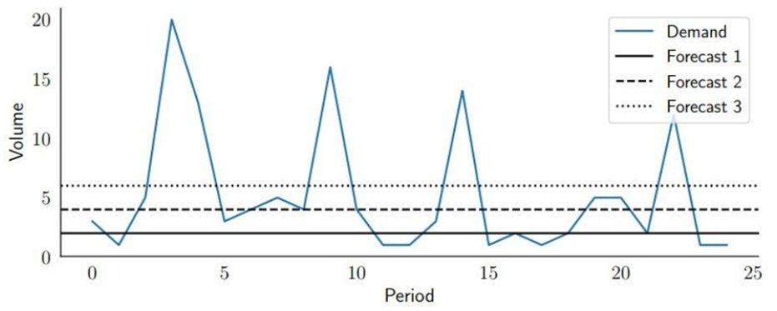
An example…
Consider these predictions

Slide 61
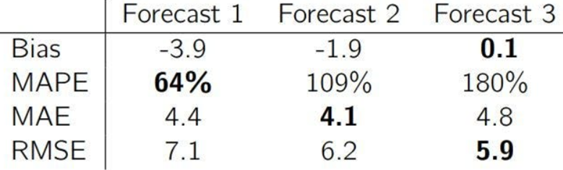
An example…
Consider these predictions
And their evaluation with different intrinsic metrics

Slide 62

An example…
Consider these predictions
And their evaluation with different intrinsic metrics

Slide 63
An example…
Consider these predictions
And their evaluation with different intrinsic metrics
No free lunch theorem
Different ML metrics have different good and bad properties
Consider multiple (not correlated) ML metrics
Try to define Business metrics
If not possible, align Business with ML metrics

Slide 64
Rules of Thumb for Picking Evaluation Protocols
No free lunch theorem -> No Single Best Metric
Different ML metrics have different good and bad properties
Accuracy is easy, but hides the truth under the carpet
Consider multiple (not correlated) ML metrics -> then pick what works best
Try to define Business metrics -> at least an approximation
If not possible, align Business with ML metrics

Slide 65
Example Applications

Slide 66
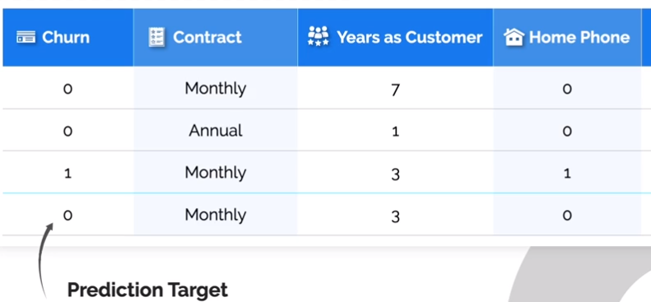
Example 1
You work with a telecommunication company and you want to predict which customers are going to churn (quit on their contracts)
Why? Offer them a discount in order to stay!!
This is your dataset.
Your task is build a classification model for churn/no churn

Slide 67
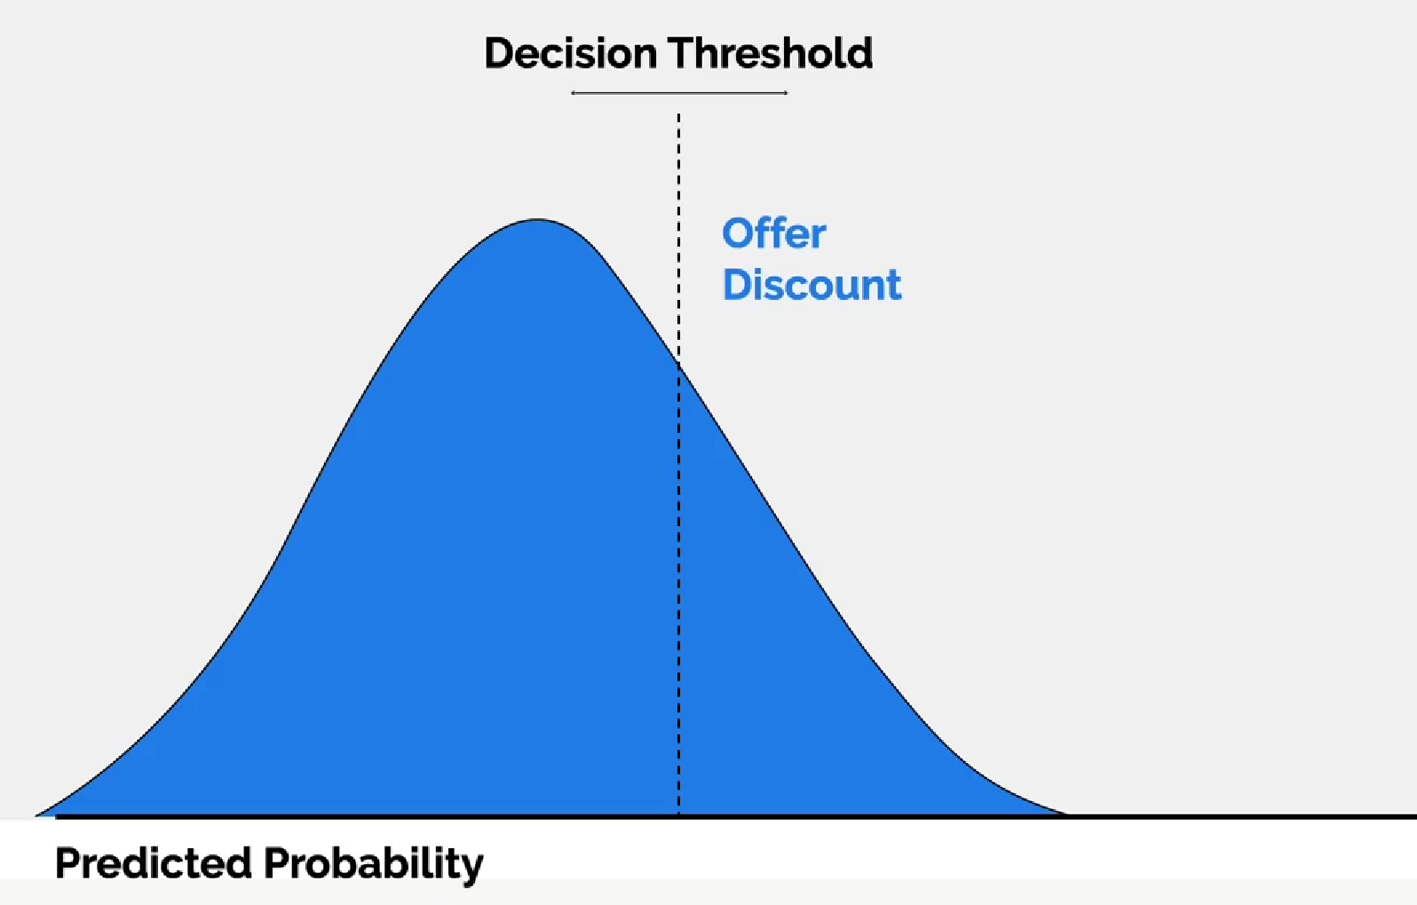
Example 1: Turn predictions into decisions

Slide 68
Example 1: Turn predictions into decisions
After this threshold, the customer will churn
Threshold is adjustable
By default this 0.5
BUT CAN BE ADJUSTED

Slide 69
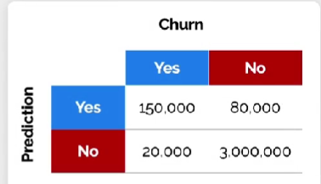
Example 1: Turn predictions into decisions
Confusion Matrix
Financial losses of each decision
After this threshold, the customer will churn
Threshold is adjustable
By default this 0.5
BUT CAN BE ADJUSTED

Slide 70
Example 1: Turn predictions into decisions
Confusion Matrix
Financial losses of each decision
After this threshold, the customer will churn
Threshold is adjustable
Predictions on the confusion matrix vary based on the threshold
Why 50% is not a good option?
Because offering discounts costs money.
Lower thresholds
=> more discounts => less money
We need a balance!!

Slide 71
How to pick the threshold?
How to Translate Outcomes to Financial Impact!

Slide 72
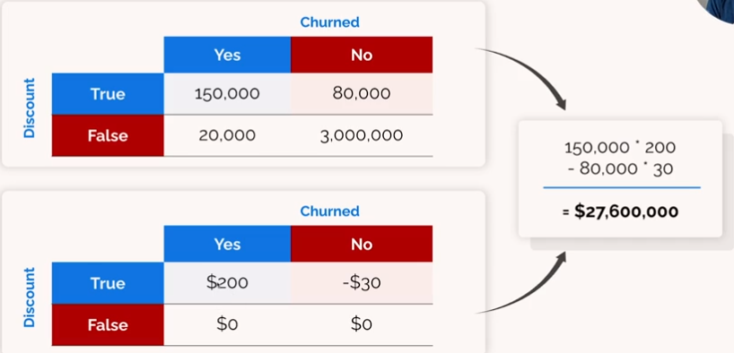
How to pick the threshold?
How to Translate Outcomes to Financial Impact!
Confusion matrix
Total customers in each category
Varies with the different thresholds!!

Slide 73
How to pick the threshold?
How to Translate Outcomes to Financial Impact!
Confusion matrix
Total customers in each category
Varies with the different thresholds!!
Payoff matrix
Cost or profit in case we offer a discount.
If we predicted correct we get 200$. If we predict wrong we lose 30$

Slide 74
How to pick the threshold?
How to Translate Outcomes to Financial Impact!
Confusion matrix
Total customers in each category
Varies with the different thresholds!!
Payoff matrix
Cost or profit in case we offer a discount.
If we predicted correct we get 200$. If we predict wrong we lose 30$

Slide 75
How to pick the threshold?
We get 150.000 correct
We loss 80.000
How to Translate Outcomes to Financial Impact!
Confusion matrix
Total customers in each category
Varies with the different thresholds!!
Payoff matrix
Cost or profit in case we offer a discount.
If we predicted correct we get 200$. If we predict wrong we lose 30$
What if I adjust the threshold?

Slide 76
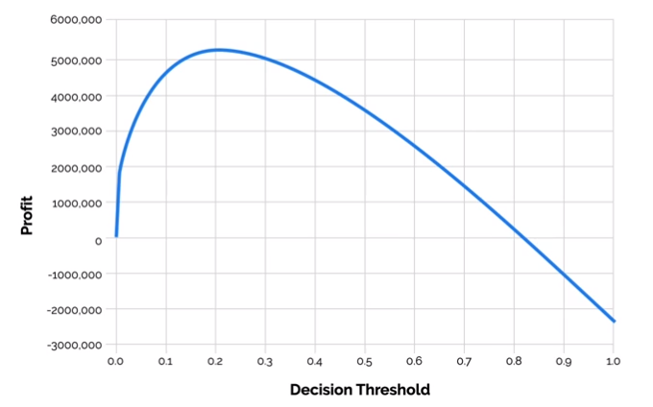
Profit Curves: Optimize the Threshold
Given a payoff matrix we can find the profit on different thresholds!
Estimated as before

Slide 77
Profit Curves: Optimize the Threshold
Given a payoff matrix we can find the profit on different thresholds!
Max profit
Ideal threshold!!
Estimated as before

Slide 78
Profit Curves: Optimize the Threshold
Given a payoff matrix we can find the profit on different thresholds!
Max profit
Ideal threshold!!
This is how we align Business Metrics with ML Metrics
Estimated as before

Slide 79
Show me the code

Slide 80
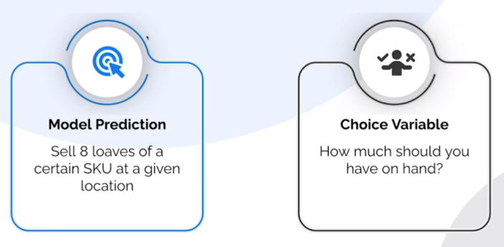
Example 2: Optimize Decisions on Regression problems

Slide 81
Lets Extend Profit Curves
Assume the cost of excess inventory for an item is 1€/unit
Assume the cost of insufficient inventory is 3€/unit
A model predicts demand for tomorrow will be 8 units
How many items should you have on your inventory?
Careful: This is a super hard problem :)

Slide 82
Lets Extend Profit Curves
Assume the cost of excess inventory for an item is 1€/unit
Assume the cost of insufficient inventory is 3€/unit
A model predicts demand for tomorrow will be 8 units
If the model is perfect -> I should order 8 units!! Maximize profits.
Is the model perfect?
If the model is very wrong, maybe I should order a lot extra than the prediction
If the model is very good, maybe I should not order a lot extra than the prediction
I need to investigate the performance of my model!

Slide 83
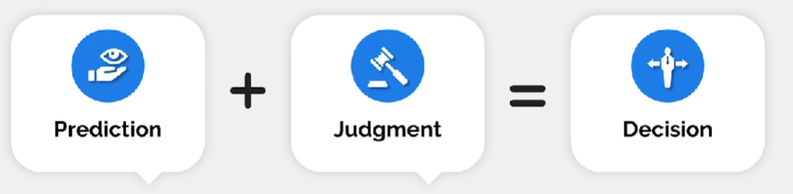
The standard framework of a Data Scientist
Stakeholders contribution
Your contribution

Slide 84
Show me the code

